Slide 1
Task2: Banks lend money to each other. In tough economic times, if a bank goes bankrupt, it may not be able to pay back the loan. A bank’s total assets are its current balance plus its loans to other banks. The diagram below shows five banks. The banks’ current balances are 25, 125, 175, 75, and 181 million dollars, respectively. The directed edge from node 1 to node 2 indicates that bank 1 lends 40 million dollars to bank 2.
If a bank’s total assets are under a certain limit, the bank is unsafe. The money it borrowed cannot be returned to the lender, and the lender cannot count the loan in its total assets. Consequently, the lender may also be unsafe, if its total assets are under the limit.
Write a program to find all the unsafe banks. Your program reads the input as follows.
1. It first reads two integers n and limit, where n indicates the number of banks and limit is the minimum total assets for keeping a bank safe.
2. It then reads n lines that describe the information for n banks with IDs from 0 to n-1.
The first number in the line is the bank’s balance, the second number indicates the number of banks that borrowed money from the bank, and the rest are pairs of two numbers. Each pair describes a borrower. The first number in the pair is the borrower’s ID and the second is the amount borrowed. For example, the input for the five banks in above picture is as follows (note that the limit is 201):
Number of banks: 5
Minimum asset limit: 201
Bank # 0 -> Balance: 25 -> Number of banks Loaned: 2 -> Bank ID: 1 -> Amount: 100.5 -> Bank ID: 4 -> Amount: 320.5
Bank # 1 -> Balance: 125 -> Number of banks Loaned: 2 -> Bank ID: 2 -> Amount: 40 -> Bank ID: 3 -> Amount: 85
Bank # 2 -> Balance: 175 -> Number of banks Loaned: 2 -> Bank ID: 0 -> Amount: 125 -> Bank
ID: 3 -> Amount: 75
Bank # 3 -> Balance: 75 -> Number of banks Loaned: 1 -> Bank ID: 0 -> Amount: 125
Bank # 4 -> Balance: 181 -> Number of banks Loaned: 1 -> Bank ID: 2 -> Amount: 125
The total assets of bank 3 are (75 + 125), which is under 201, so bank 3 is unsafe. After bank 3 becomes unsafe, the total assets of bank 1 fall below (125 + 40). Thus, bank 1 is also unsafe.
The output of the program should be
Unsafe banks are 3 and Bank 1

Slide 2
Case | Input | Output | Result
1. Normal case | java ca.jay.jac444.workshop4.W4Task2 market.txt \t | Unsafe banks are Bank 3 and Bank 1 | OK
2. No Unsafe bank | java ca.jay.jac444.workshop4.W4Task2 market.txt \t | Unsafe banks are not exist! | OK
3. Not match delimiter and file format | java ca.jay.jac444.workshop4.W4Task2 market.txt w | Check your delimiter | OK
4. Data empty check | java ca.jay.jac444.workshop4.W4Task2 market.txt \t | In file, the value cannot be empty | OK
5. Include no digit data | java ca.jay.jac444.workshop4.W4Task2 market.txt \t | In file, the value must be a double or an integer | OK
6. Bank row has only one data | java ca.jay.jac444.workshop4.W4Task2 market.txt \t | In file, the number of elements of bank line must be at least two | OK
7. Mismatch the line number | java ca.jay.jac444.workshop4.W4Task2 market.txt \t | In file, there is not matched between the number of bank of file and the actual number of bank | OK

Slide 3
Case | Input | Output | Result
8. Lender and borrower are the same | java ca.jay.jac444.workshop4.W4Task2 market.txt \t | In file, bank id and borrower id cannot be the same | OK
9. Loan money is 0 | java ca.jay.jac444.workshop4.W4Task2 market.txt \t | The loan money cannot be 0 | OK
10. Insufficient arguments number | java ca.jay.jac444.workshop4.W4Task2 market.txt Or java ca.jay.jac444.workshop4.W4Task2 | It needs a command-line arguments for a file name and delimiter | OK
11. File not found | java ca.jay.jac444.workshop4.W4Task2 market.tx \t | It cannot find the file | OK
12. Change delimiter in file (from ‘\t‘ to ‘,’) | java ca.jay.jac444.workshop4.W4Task2 market.txt , | Unsafe banks are Bank 3 and Bank 1 | OK

Slide 4
Test file: market.txt
5
201
25 2 1 100.5 4 320.5
125 2 2 40 3 85
175 2 0 125 3 75
75 1 0 125
181 1 2 125

Slide 5
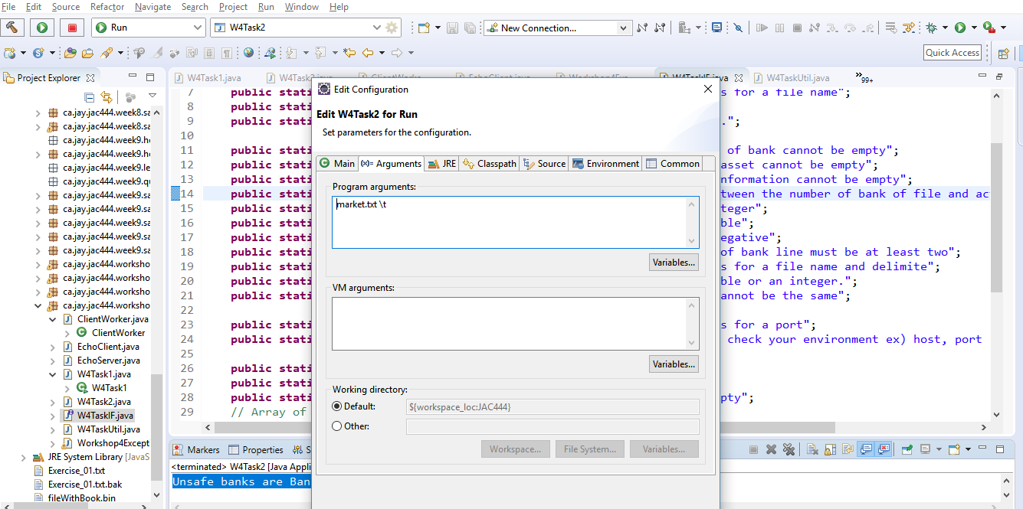
Case1. Normal case:
Set “market.txt \t” in arguments field in IDE tool and run it
(or run “java ca.jay.jac444.workshop4.W4Task2 market.txt \t” in command-line

Slide 6
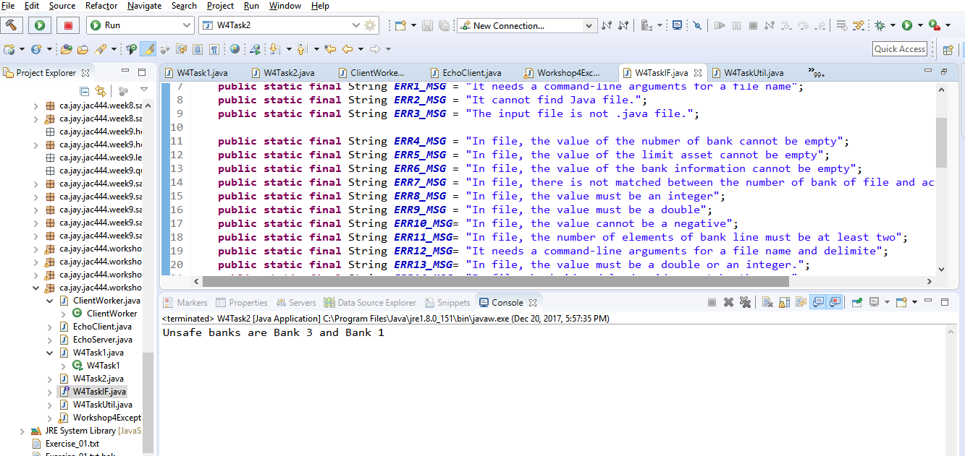
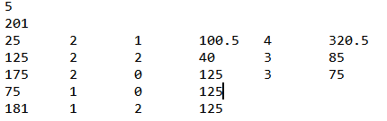
Case1. Normal case:
Check the message: “Unsafe banks are Bank 3 and Bank 1”
Data file
Normal message is displayed

Slide 7
Case2. No Unsafe bank:
Set “market.txt \t” in arguments field in IDE tool and run it
(or run “java ca.jay.jac444.workshop4.W4Task2 market.txt \t” in command-line

Slide 8
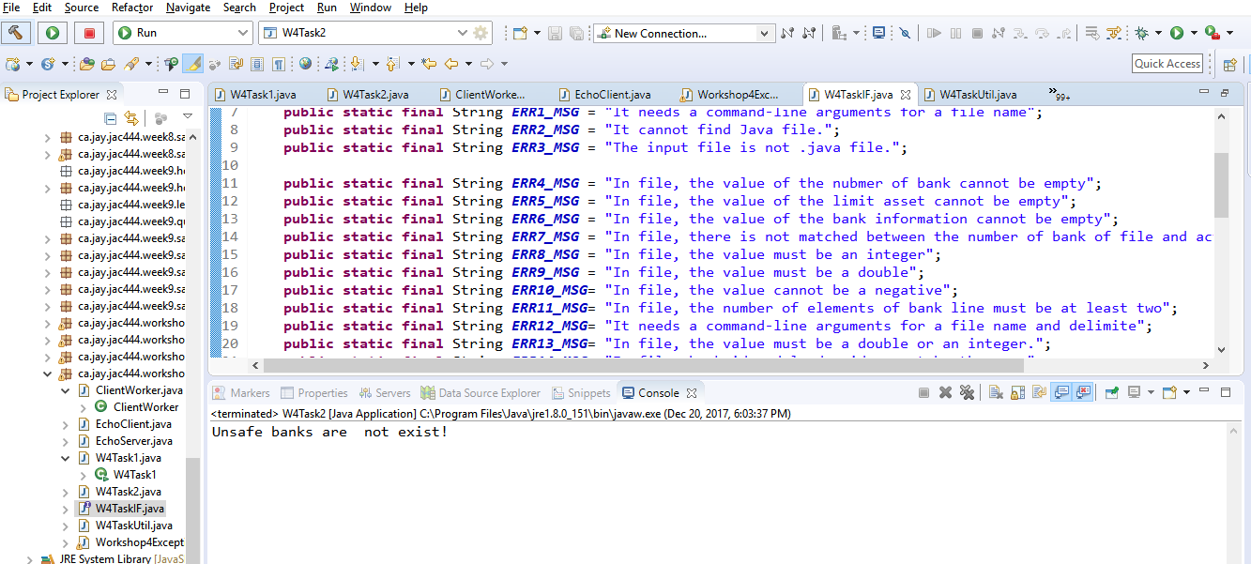
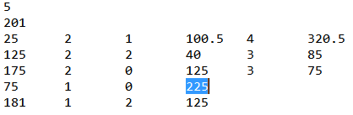
Case2. No Unsafe bank :
Check the message: “Unsafe banks are not exist!”
Data file: change from 125 to 225
Normal message is displayed

Slide 9
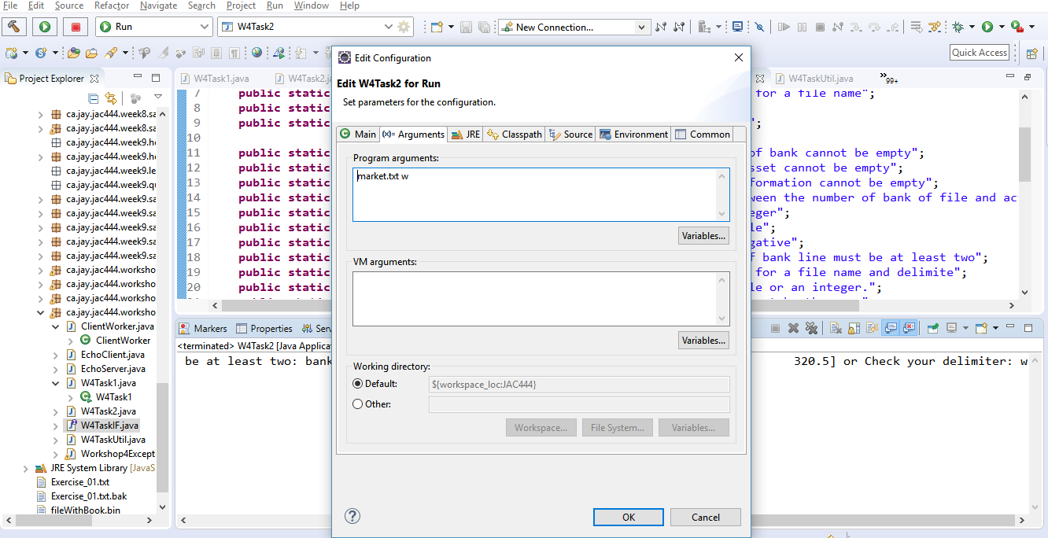
Case3. Not match delimiter and file format:
Set “market.txt w” in arguments field in IDE tool and run it
(or run “java ca.jay.jac444.workshop4.W4Task2 market.txt w” in command-line

Slide 10
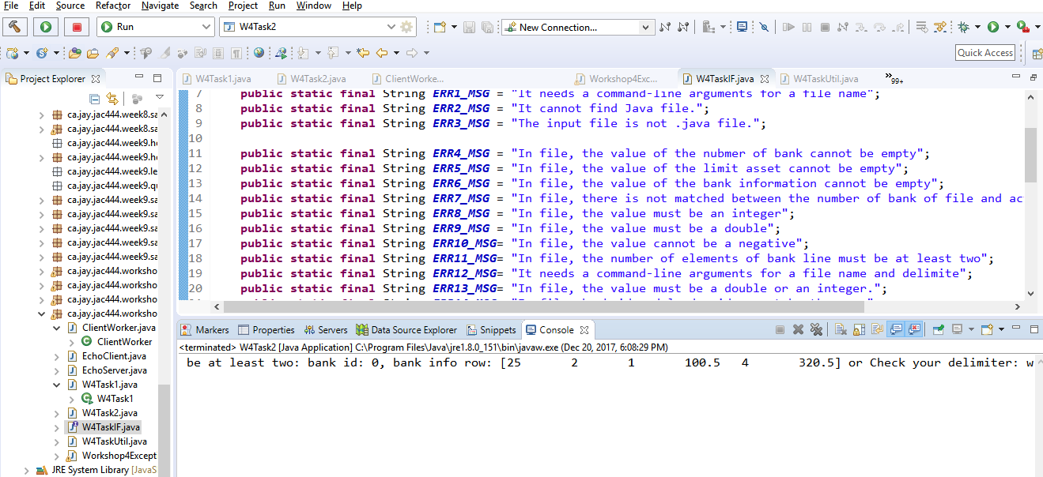
Case3. Not match delimiter and file format :
Check the message: “Check your delimiter”
error message is displayed

Slide 11
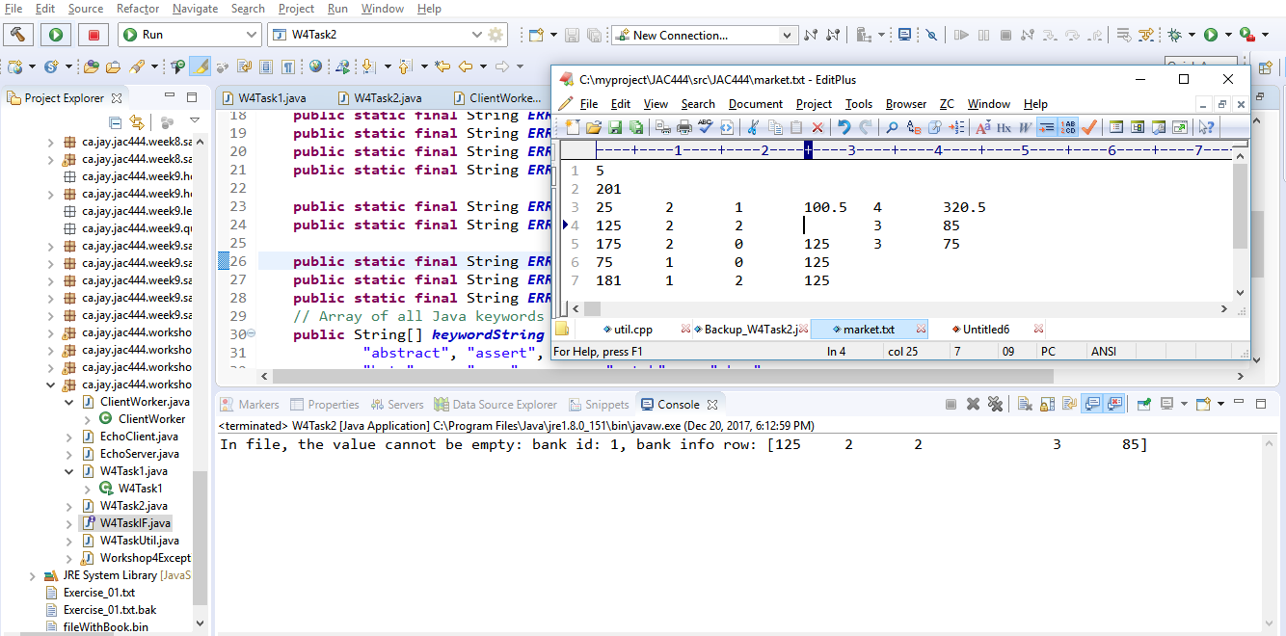
Case4. Data empty check :
Check the message: “In file, the value cannot be empty”
Delete an element
error message is displayed

Slide 12
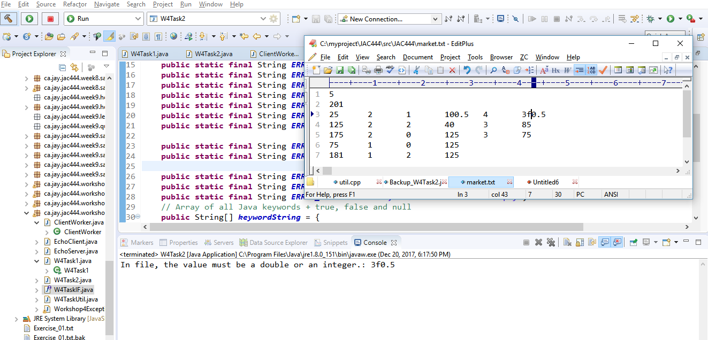
Case5. Include no digit data :
Check the message: “In file, the value must be a double or an integer”
Insert character to an element
error message is displayed

Slide 13
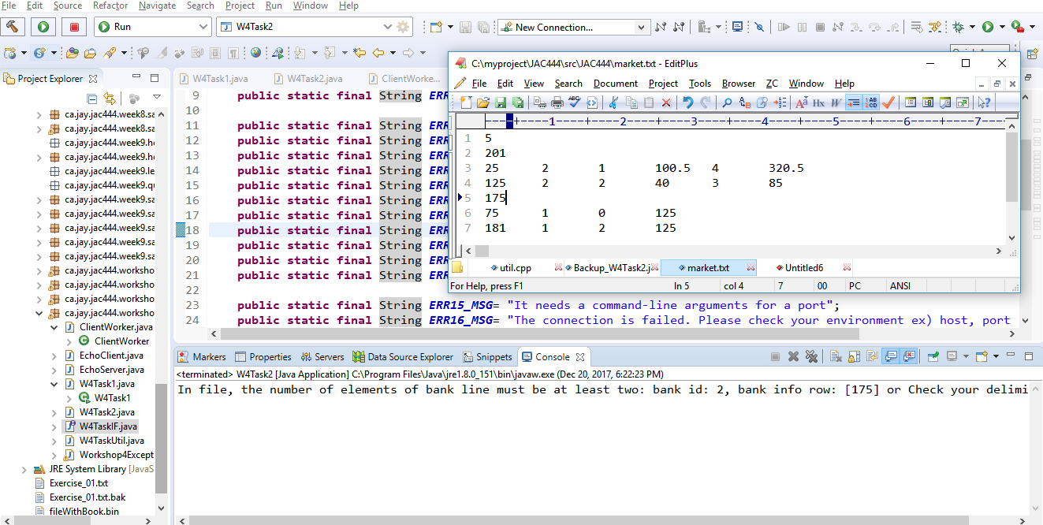
Case6. Bank row has only one data :
Check the message: “In file, the number of elements of bank line must be at least two”
Delete an element
error message is displayed

Slide 14
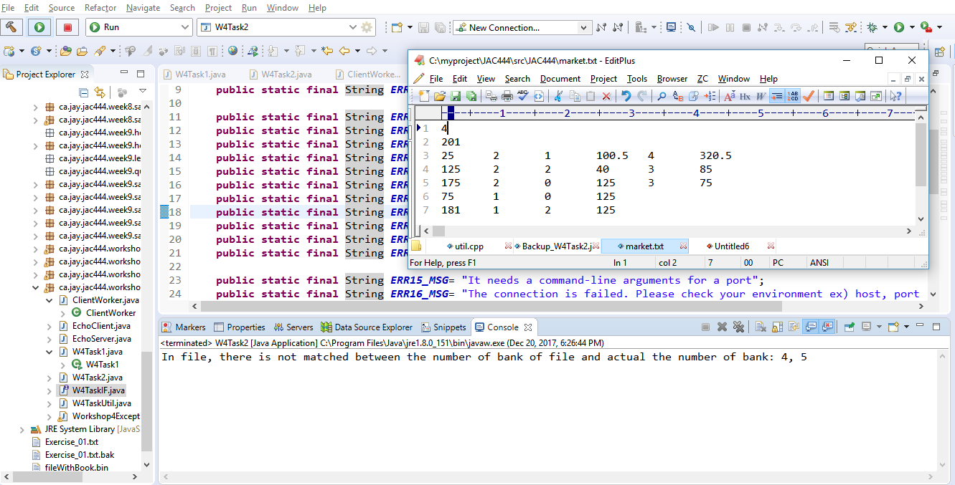
Case7. Mismatch the line number :
Check the message: “In file, there is not matched between the number of bank of file and actual the number of bank”
Change bank number
error message is displayed

Slide 15
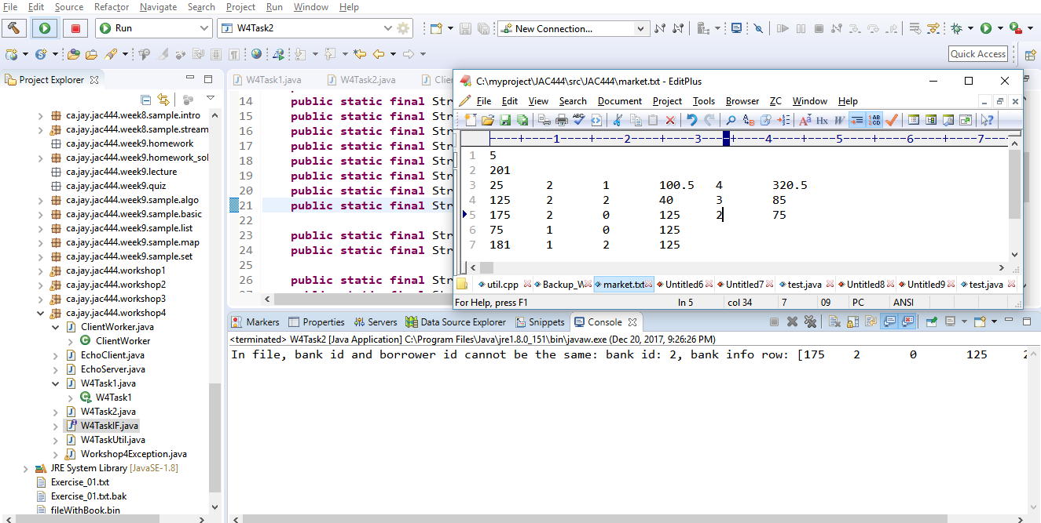
Case8. Lender and borrower are the same:
Check the message: “In file, bank id and borrower id cannot be the same: bank id: 0, bank info row”
Change borrower’s bank id to own bank id
error message is displayed

Slide 16
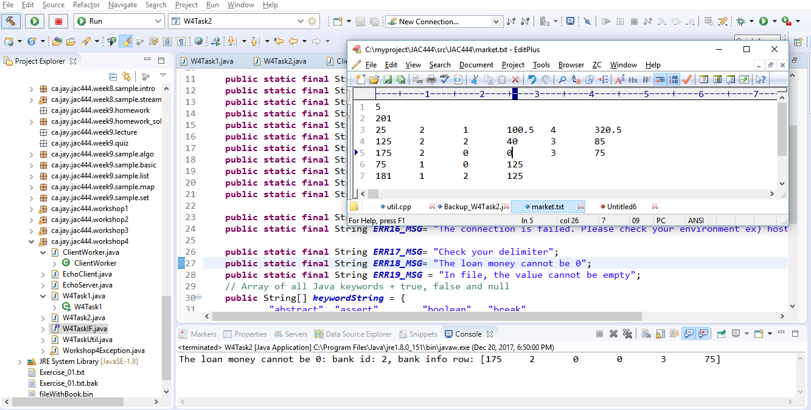
Case9. Loan money is 0 :
Check the message: “The loan money cannot be 0: bank id: 1”
Change loan money to 0
error message is displayed

Slide 17
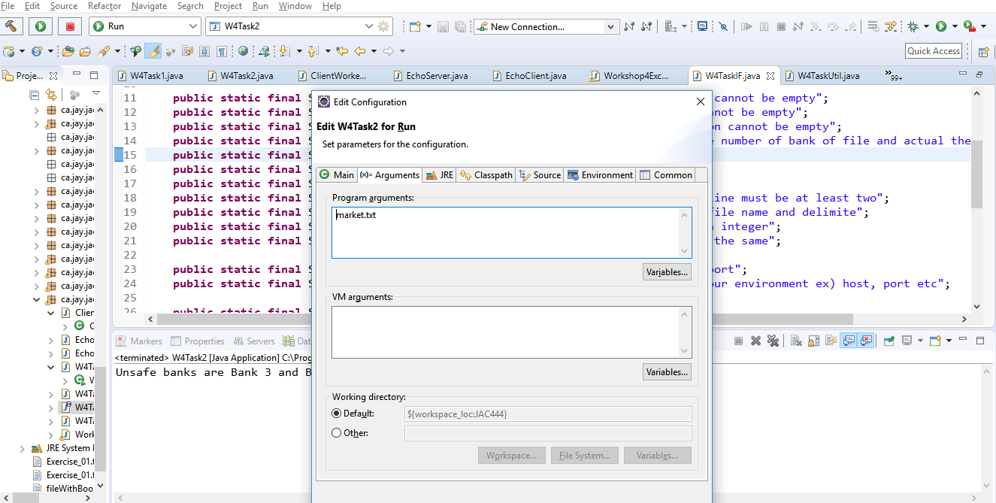
Case10. Insufficient arguments number :
Set “market.txt” in arguments field in IDE tool and run it
(or run “java ca.jay.jac444.workshop4.W4Task2 market.txt” in command-line
error message is displayed

Slide 18
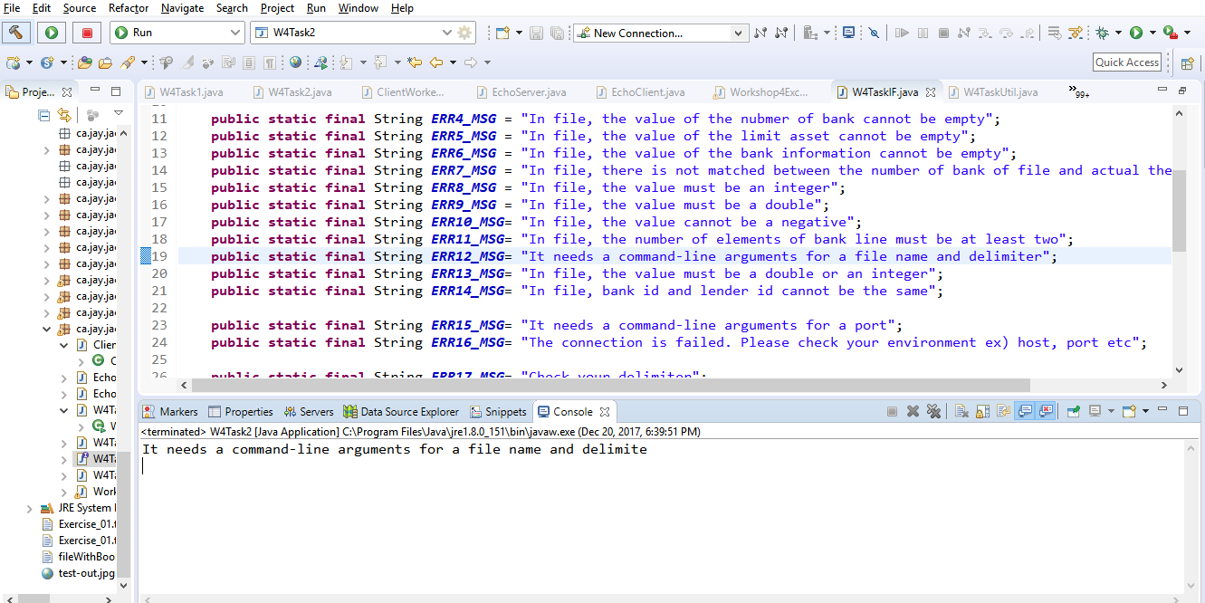
Case10. Insufficient arguments number:
Check the message: “It needs a command-line arguments for a file name and delimiter”
error message is displayed

Slide 19
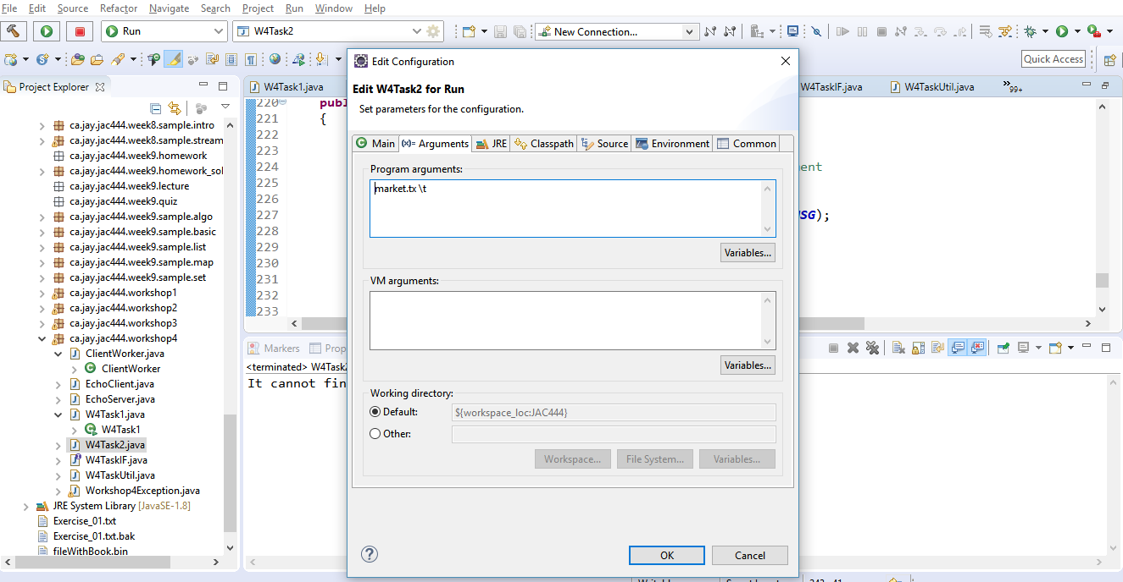
Case11. File not found:
Set “market.tx w” in arguments field in IDE tool and run it
(or run “java ca.jay.jac444.workshop4.W4Task2 market.tx w” in command-line

Slide 20
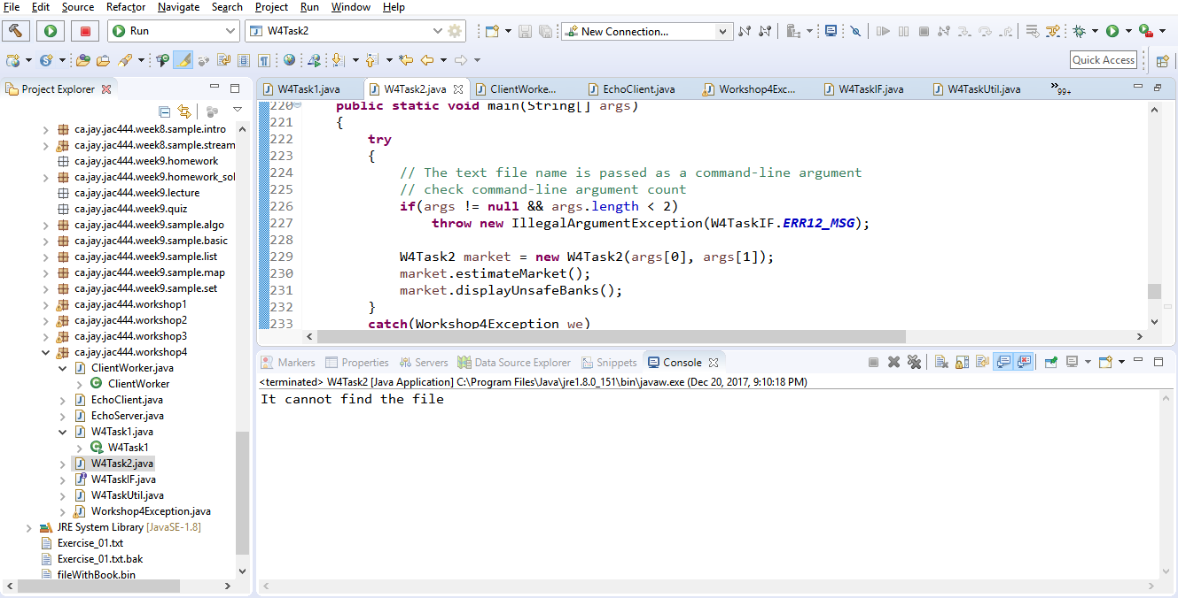
Case11. File not found :
Check the message: “It cannot find the file”
error message is displayed

Slide 21
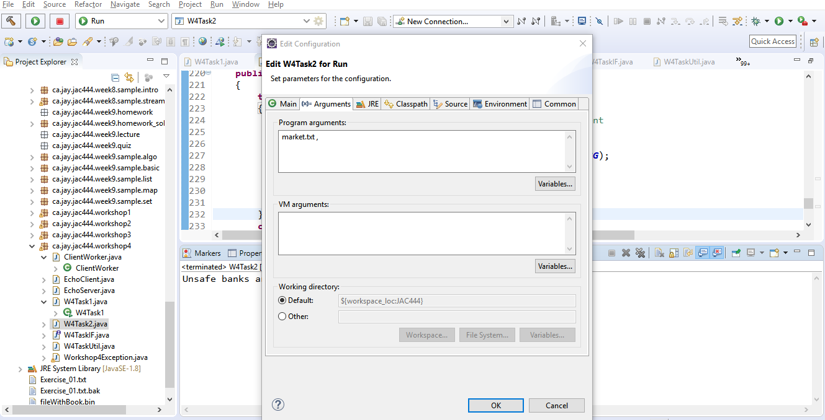
Case12. Change delimiter in file (from ‘\t‘ to ‘,’):
Set “market.txt ,” in arguments field in IDE tool and run it
(or run “java ca.jay.jac444.workshop4.W4Task2 market.tx ,” in command-line

Slide 22
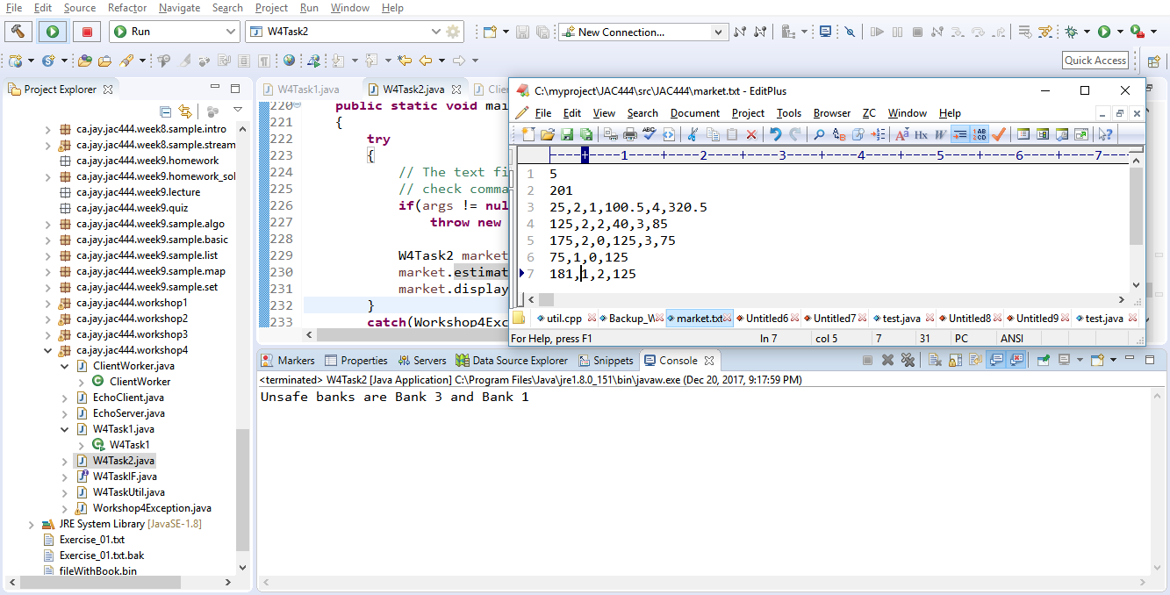
Case12. Change delimiter in file (from ‘\t‘ to ‘,’):
Check the message: “Unsafe banks are Bank 3 and Bank 1”
Change delimiter to ‘,’
Normal message is displayed

